Slide 1
Object Detecting
Name: Md Adnan Shariar
ID: 1521948042

Slide 2
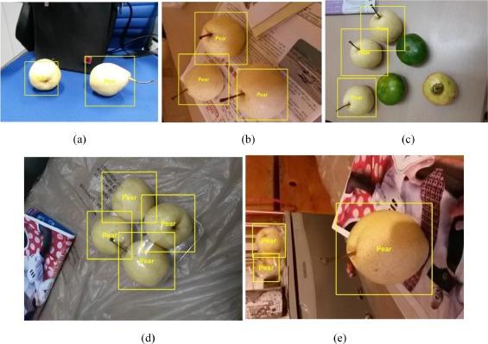
Data collecting and Model Building
I am using Convolutional Neural Network(CNN) algorithm for building my model
We have collected our Dataset from Kaggle. Dataset contain more than 28000 images

Slide 3
In a CNN, convolution layers play the role of feature extractor
And CNN is an artificial neural network that is so far been most popularly used for analysis images.

Slide 4
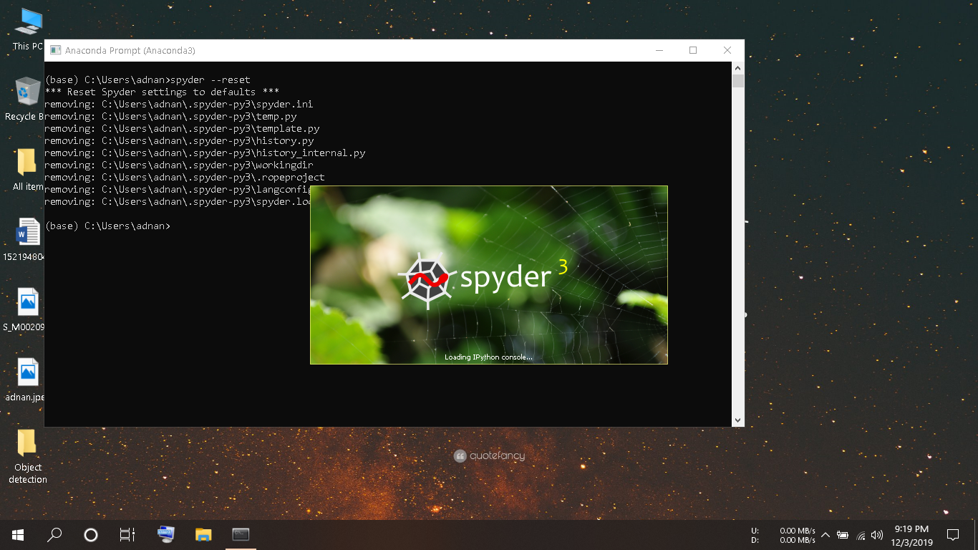

Slide 5
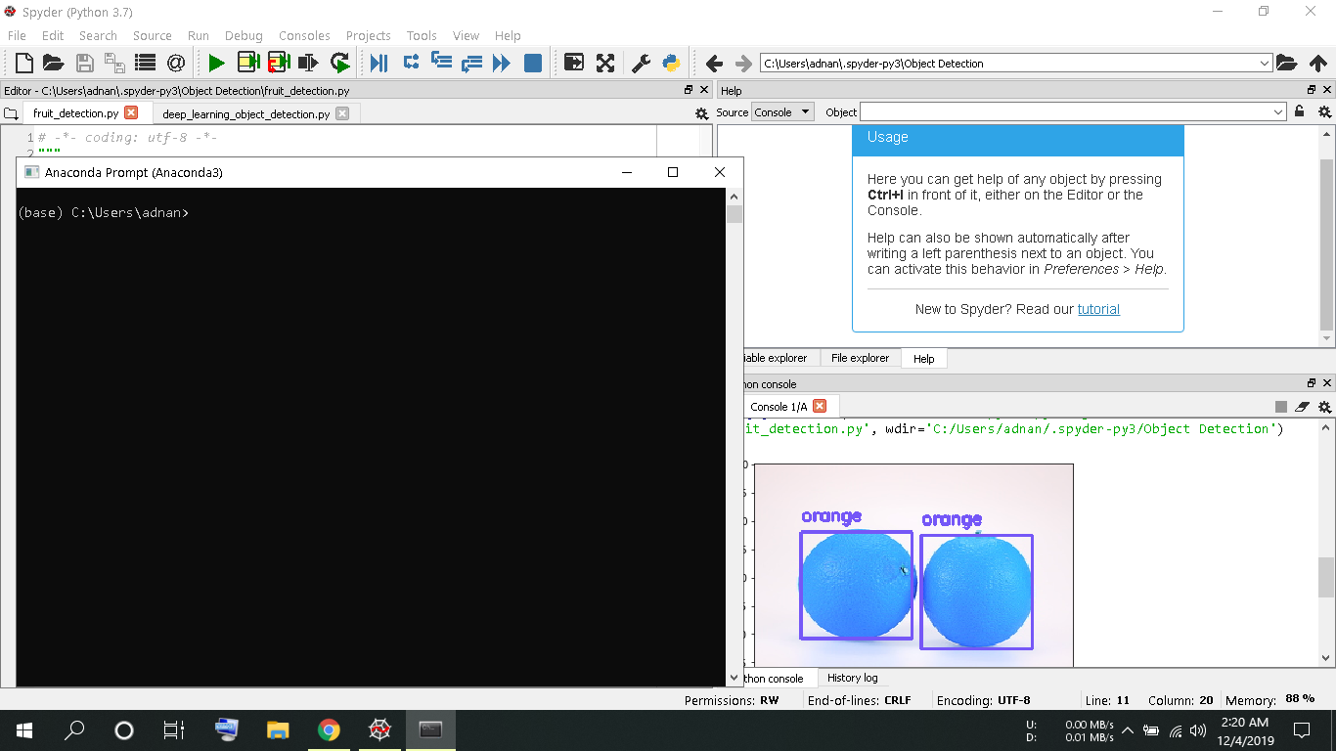

Slide 6
THANK YOU

